Slide 1
Student Satisfaction and Priorities
Student Satisfaction Inventory™ (SSI)
Notes:
Note: Ruffalo Noel Levitz is RNL.

Slide 2
The Student Satisfaction Inventory(SSI)
administration at Germanna Community College

Slide 3
Definition of Satisfaction:
When expectations are met or exceeded by the student’s perception of the campus reality.
Schreiner & Juillerat, 1994
Notes:
What is satisfaction? The authors of the Student Satisfaction Inventory define it as, “when expectations are met or exceeded by the student’s PERCEPTION of the campus reality. You can see that a key word in this definition is PERCEPTION and it is important to keep in mind that perception really is reality. The other important word here is EXPECTATIONS because they provide the context with which to consider the student experience. Regardless of what we think the situation may be on our campus, it is the students’ perceptions that matter because that is their reality.

Slide 4

Why measure student satisfaction and priorities?
Evidence-based research has documented strong links between students’ scores on RNL Satisfaction-Priorities Surveys with several areas, including…
To review the research: www.RuffaloNL.com/Benchmark
Notes:
Research has shown that there are links between student satisfaction and higher individual student retention, higher institutional graduation rates and higher institutional alumni giving. These are all metrics that are regularly tracked by colleges and universities and it important to know that student satisfaction can have a positive impact on these areas. To see the full reports that support these observations, go to RuffaloNL.com/benchmark.

Slide 5
Four primary ways to use satisfaction data
Retention
Strategic Planning
Accreditation
Recruitment
Notes:
Institutions have shared with RNL that they use satisfaction data for a variety of efforts on their campuses. These include using the data
For retention and student success efforts. Campuses are using their identified strengths to re-recruit their current students by reminding them of what the college does well according to their student reported data.
They are also using the data to provide the student voice in strategic planning activities
The satisfaction data are certainly valuable for documentation with your accreditation efforts, where the items have been mapped to the regional accreditation criteria
And campuses are using the data for recruitment efforts-highlighting their strengths in their marketing messages in order to attract students who value what they do well.
We will want to look for ways to expand the use of our data on campus to ultimately broaden our return on your investment.

Slide 6
Definitions
Strengths: Survey items that students rated in the top half of importance and in the top quartile of satisfaction, relative to the other survey items.
Challenges: Survey items in the top half of importance and the bottom quartile of satisfaction or in the top half of importance and the top quartile of the performance gaps for the data set.
Performance gap: The difference between the importance score and the satisfaction score.
Notes:
Before we take a closer look at the findings, I want to share with you how RNL defines institutional strengths and institutional challenges. Strengths are items of high importance and high satisfaction. These are the items that students care about that should be celebrated because the institution is performing relatively well. Challenges are those items that are also very important to students, but have lower satisfaction scores or large performance gaps. These are the priority areas for attention at the institution because students reflect high expectations but believe there is room for improvement. And performance gaps are simply the importance score minus the satisfaction score. The larger the gap, the greater the difference between what students expect and their perception of their current experience. Keep in mind that these results are all student perceptions, but we also know that perception is reality.

Slide 7
Matrix for prioritizing action
Institutional
Challenges
Very Important
Institutional
Strengths
Very Dissatisfied
Very Satisfied
Very Unimportant
Copyright to 1994-2019 Ruffalo Noel Levitz
Notes:
A visual way to think about the identification of the strengths and challenges is with this matrix for prioritizing action which reflects the core conceptual concept of the RNL satisfaction and priorities surveys. We will want to stay focused on the items that are in the top half of importance for our students.

Slide 8
Our survey administration
This equals
7%
response rate
The Student Satisfaction Inventory was administered in the spring of 2024
A total of 364 students completed the survey.
5,472 students were invited to complete the survey online.

Slide 9
Our institutional strengths
These are the top areas our students care about, where we are meeting their expectations:
The campus is safe and secure for all students.
This campus provides online access to services I need.
There are convenient ways of paying my school bill.
Financial aid counseling is available if I need it.
Students are made to feel welcome here.
Tutoring services are readily available.
On the whole, the campus is well-maintained.

Slide 10
Changes in institutional strengths
These are changes to our institutional strengths since the last administration.
New strengths
Financial aid counseling is available if I need it.

Slide 11
Our institutional challenges
These are the key areas to improve, based on the priorities of our students:
My academic advisor is knowledgeable about my program requirements.
There are sufficient courses within my program of study available each term.
The quality of instruction I receive in most of my classes is excellent.
Classes are scheduled at times that are convenient for me.
My academic advisor is knowledgeable about transfer requirements of other schools.
Financial aid awards are announced in time to be helpful in college planning.
My advisor helps me apply my program of study to career goals.
Computers and/or Wi-Fi are adequate and accessible.

Slide 12
Changes in institutional challenges
These are changes to our institutional challenges since the last administration.
New challenges
My advisors helps me apply my program of study to my career goals.
Computers and/or Wi-Fi are adequate and accessible.
No longer challenges
Administrators are available to hear students’ concerns.
Faculty provide timely feedback about my academic progress.

Slide 13
Other notable items
These are other items of significance.
Higher satisfaction vs. comparison group
Tutoring services are readily available.
There are convenient ways of paying my school bill.
Lower satisfaction vs. comparison group
Computers and/or Wi-Fi are adequate and accessible.

Slide 14
Scale Rankings
Comparison of scores by demographics
Nursing students no longer have lower satisfaction scores than students as a whole (but higher gaps still exist).
White students have lower satisfaction scores (and higher gaps) than Black or Hispanic students.
Male students have lower satisfaction scores (but lower gaps) than female students.

Slide 15
Scale Rankings
This is a ranking of the question cluster scales by level of satisfaction.
Scales with highest levels of satisfaction
Safety and Security
Campus Services
Scales with lowest levels of satisfaction
Student Centeredness
Academic Advising Effectiveness

Slide 16
The importance of institutional choice
Students attending their first choice institution are more likely to have higher satisfaction levels overall.

Slide 17
What factors influence our students to enroll?
It is important to understand why students enroll here. The percentage of student saying the following factors were important or very important:

Slide 18
Bottom line indicator: Satisfaction
How satisfied are our students compared with students nationally?
Notes:
While students scale scores were higher, students report being less satisfied overall.

Slide 19
Bottom line indicator: Re-enrollment
How likely are our students to enroll again if they had it to do over, compared with students nationally?

Slide 20
Next steps on our campus:
These are our planned next steps with using the data on campus:
Drill down on comments.
Plan for next meeting to discuss recommendations.

Slide 21
Systematic Assessment Cycle
Inform the campus
Survey your students
Respond to the data with new initiatives
Review and share the results
Explore the data
Notes:
You can share this slide as appropriate. This is a recommended five step assessment cycle to actively review, share, explore and use your data, as well as close the feedback loop by informing the campus, especially before you survey again.

Slide 22
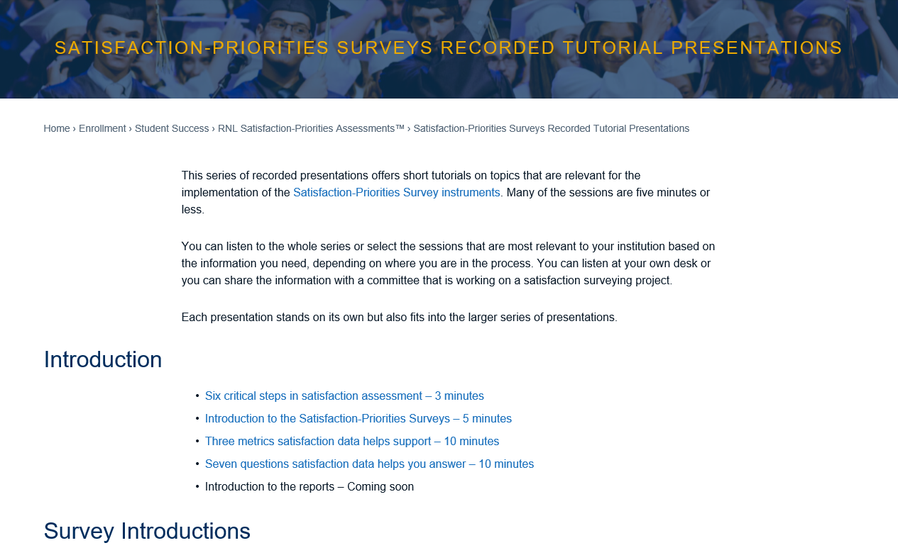
For a series of short tutorials, visit: www.RuffaloNL.com/SatisfactionSurveyTutorials
Notes:
There is additional on-demand content on the RNL Website that you and your team may be interested in reviewing. Most tutorials are only 5 to 7 minutes in length.

Slide 23
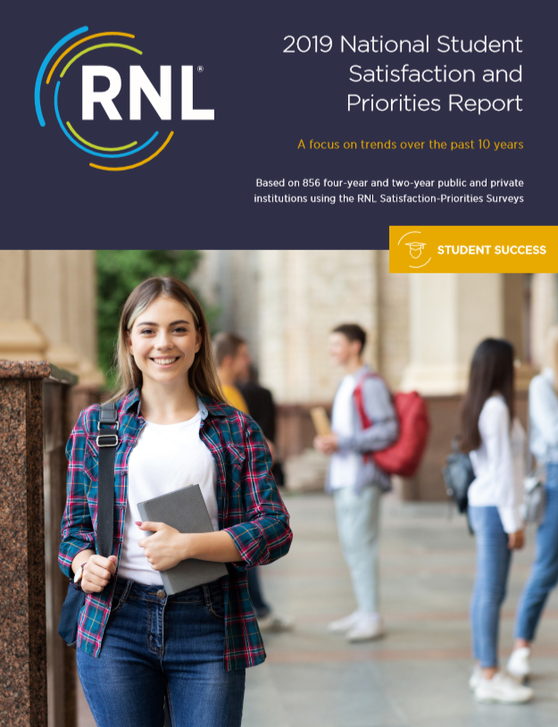
Download the report from here:
www.RuffaloNL.com/Benchmark
Results from the RNL Student Satisfaction Inventory™ (SSI),
RNL Adult Student Priorities Survey™ (ASPS) or the RNL Priorities Survey for Online Learners™ (PSOL)
Notes:
You may also want to download the 2020 national student satisfaction and priorities report. The results from this report are based on the students completing the RNL Student Satisfaction Inventory or the Adult Student Priorities Survey or the Priorities Survey for Online Learners. The 2019 report looks at trends across the past ten years.

Slide 24


Learn more about the RNL
Satisfaction-Priorities Surveys:
www.RuffaloNL.com/SatisfactionSurveys
Julie Bryant
Associate Vice President
Julie.Bryant@RuffaloNL.com
319.247.4735
Shannon Cook
Senior Director
Shannon.Cook@RuffaloNL.com
319.247.4736
Notes:
Please contact Julie Bryant or Shannon Cook at RNL with any questions.

